Slide 1
“Before the world was, consciousness was.
In consciousness it comes into being, in consciousness it lasts and into pure consciousness it dissolves.
At the root of everything, is the feeling 'I am’."
Sri Nisargadatta Maharaj
Jnana guru
1897-1981
Bombay
In Jnana yoga, the mind is used to inquire into its own nature and to transcend its identification with thoughts and ego.

Slide 2
All blessings come from within. Turn within. 'I am' you know. Be with it all the time you can spare, until you revert to it spontaneously. There is no simpler and easier way.

Slide 3
In the immensity of consciousness a light appears, a tiny point that moves rapidly and traces shapes, thoughts and feelings, concepts and ideas, like a pen writing on paper. And the ink that leaves a trace is memory.
You are that tiny point of light and by your movement the world is ever re-created. Stop moving and there will be no world.
Look within and you will find that the point of light is the reflection of the immensity of light in the body, as the sense 'I am'. There is only light, all else appears.

Slide 6
Siddharameshwar Maharaj
Navnath Sampradaya
(lineage of the nine gurus)

Slide 7
When I say 'I am', I do not mean a separate entity with a body as its nucleus.
I mean the totality of being, the ocean of consciousness, the entire universe of all that is and knows. I have nothing to desire for I am complete forever.

Slide 9
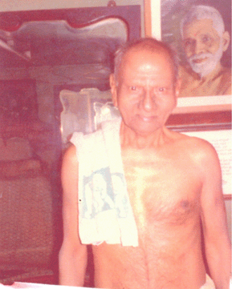

Slide 11
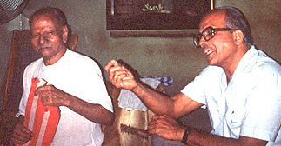

Slide 12
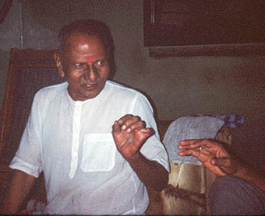

Slide 15
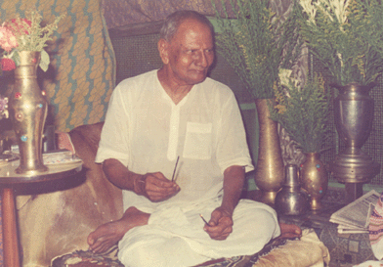

Slide 18
David Goodman
Maurice Frydman
You have tasted so many things -- all came to naught. Only the sense 'I am' persisted -- unchanged.
Go back to that state of pure being, where the 'I am' is still in its purity before it got contaminated with 'this I am' or 'that I am’.
Your burden is of false self-identifications -- abandon them all..

Slide 21
Words betray their hollowness. The real cannot be described, it must be experienced. But what the words try to convey is the highest truth.
All is one, however much we quibble.
And all is done to please the one source and goal of every desire, whom we all know as the 'I am'.

Slide 23
Establish yourself firmly in the awareness of 'I am'. This is the beginning and also the end of all endeavour.
Hold onto the sense of 'I am' to the exclusion of everything else. When thus the mind becomes completely silent, it shines with a new light and vibrates with new knowledge. It all comes spontaneously, You need only hold on to the 'I am’.
Refuse all thoughts except one: the thought 'I am'. The mind will rebel in the beginning, but with patience and perseverance it will yield and keep quiet. Once you are quiet, things will begin to happen spontaneously and quite naturally, without any interference on your part.
Just keep in mind the feeling 'I am', merge in it, till your mind and feeling become one. By repeated attempts you will stumble on the right balance of attention and affection and your mind will be firmly established in the thought-feeling 'I am'. Whatever you think, say, or do, this sense of immutable and affectionate being remains as the ever-present background of the mind

Slide 24
Maintain awareness of the internal Witness, of your sense of being, your consciousness, your “I am”
Maintain awareness of the energy that animates your very atoms
Engage in metacognition. Observe your thoughts, follow them to their origin
Meditate to lessen the small ego’s grip on your identity
Practice dispassion or equanimity (no desires)
Stay in the present moment
Peace and communication will follow

